Slide 1
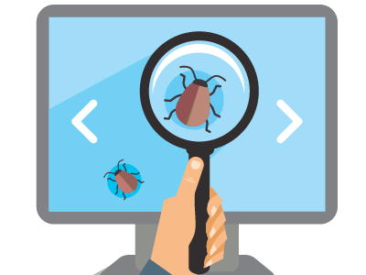
QA Fundamentals
Introduction to Software Development
QA
Fundamentals
SoftUni Team
Technical Trainers
Software University
http://softuni.bg

Slide 2

Table of Contents
What is Software?
Software Distribution Types
Retail software
Web applications
Mobile applications
Why Bugs Still Occur?
Bug Fixing Importance

Slide 3
Have a Question?
sli.do
#tech-common

Slide 4

Software Development

Slide 5



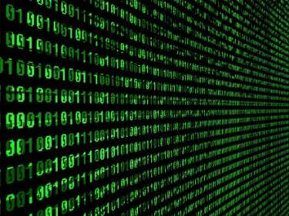
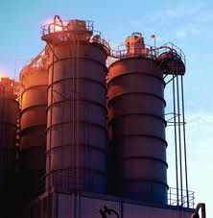

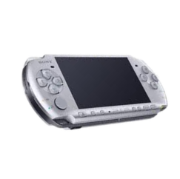
First Look at Software
Education
Business
Industry
Industry
Military
Entertainment

Slide 6
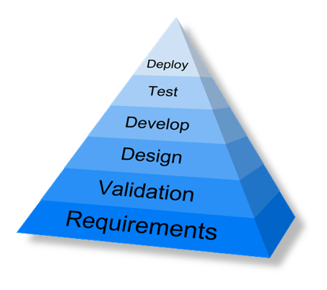
First Look at Software (2)
Developed for 8 decades
Evolved into a profession
Concerned into quality maximizing
Software engineering

Slide 7

First Look at Software (1)
Software Definition
Software is any set of machine-readable instructions that directs a computer's processor to perform specific operations

Slide 8

Types of Software
Software Distribution

Slide 9

Retail Software
The vast majority of software until the emergence of internet

Slide 10


Web Applications
The concept has been introduced in 1999 in Java Servlets
A major leap in the software distribution
Browsers and technologies are developed in favor of web apps
2005 – the term Ajax was coined
2011 – HTML5 was finalized

Slide 11


Mobile Applications
App distribution platforms began appearing in 2008
Apple app store
Google play
Windows phone store
Started as productivity and information retrieval apps
Reached bigger market share than retail software

Slide 12

Bugs!

Slide 13
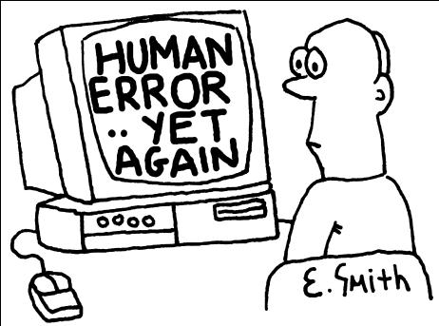
Software Defects
Human being can make an error (mistake)
Errors produce defects
Defects are faults / bugs in the program code, or in a document
If a defect in code is executed, that might cause a failure:
Fail to do what it should do
Do something it shouldn’t

Slide 14

Software Defects
The human factor:
Humans make mistakes
Poor training
Time pressure
Code complexity
Complexity of infrastructure
Changing technologies

Slide 15
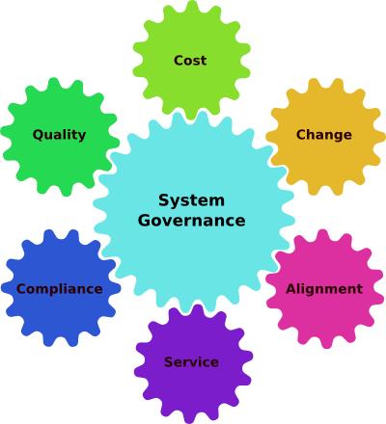
Software Defects
Organizational factors
Inefficient communication
Unclearly defined requirements
Environmental conditions
Radiation, Magnetism, Electronic fields, Pollution, Etc.
These can change the hardware conditions

Slide 16


Software Defects
Anomaly
Error
Bug
Defect
Fault
Problem
Failure
Defect/fault masking

Slide 17
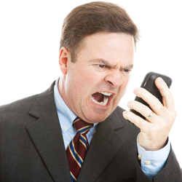
Bug Fixing Importance

Slide 18

Bug Fixing importance (2)

Slide 19

Bug Fixing Importance (3)
Unfixed bugs camouflage other bugs
Suggest quality isn’t important
Duplicate effort
Unreliable metrics and money loss
Fixing a bug today costs less than tomorrow

Slide 20

Bug Fixing Importance
What Is Testing?

Slide 21
What Is Testing? (1)
The process of exercising software
To verify that it satisfies specified requirements and to detect errors
The process of analyzing a software item
To detect the differences between existing and required conditions (that is, bugs)
To evaluate the features of the software item

Slide 22

What Is Testing? (2)
The process of operating a system or component under specified conditions
Observing or recording the results
Making an evaluation of some aspect of the system or component

Slide 23
Main Test Activities
Testing is not just running tests, but also:
Planning and control
Choosing test conditions
Designing and executing test cases
Checking results
Evaluating exit criteria
Reporting on the testing process and system under test
Finalizing or completing closure activities

Slide 24
Main Test Objectives
Testing pursues several objectives:
Finding defects
Gaining confidence about the level of quality
Providing information for decision-making
Preventing defects

Slide 25
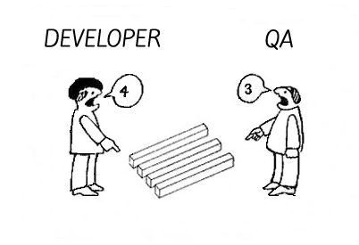
QA vs Devs (1)
QA testers:
Are perceived as destructive – only happy when they are finding faults!
Usually require good communication skills, tact & diplomacy
Normally need to be multi-talented (technical, testing, team skills)

Slide 26
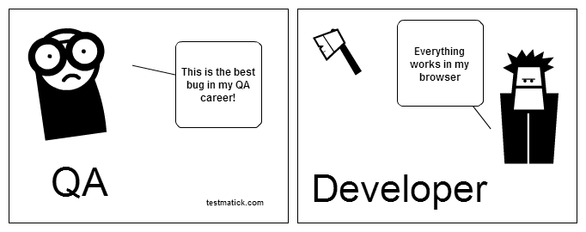
QA vs Devs (2)
Developers:
Are perceived as very creative – they write code without which there would be no system
Are rarely good communicators
Can often specialize in just one or two skills (e.g. VB ,C++,JAVA,SQL)

Slide 27
QA Responsibilities
What QAs Do?

Slide 28
Software Requirements Specification
A software requirements specification (SRS) is a description of a software system to be developed, laying out functional and non-functional requirements, and may include a set of use cases that describe interactions the users will have with the software.
Establishes the basic agreement between costumer and contractor
What software product to do
What is NOT expected to do

Slide 29
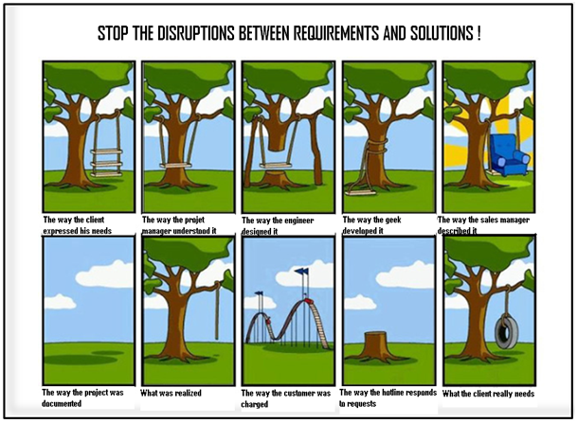

Slide 30
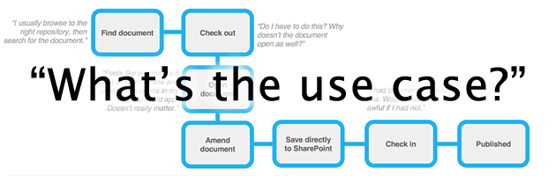
Use Cases
List of interaction steps
Defines relation between an actor and a system
Usually satisfying a goal
Actors are able to take decisions
Decisions lead to subcases

Slide 31

Use Cases (2)
Models
Can be modeled via UML
Can be flat text documents
Template
Name
Actors
Preconditions
Flow
Post conditions

Slide 32
Test Process
Begin
Test Planning and Control
Test Analysis and Design
Test Implementation and Execution
Evaluating Exit Criteria and Reporting
Test Closure Activities
End

Slide 33

Planning of The Resources
Necessary resources:
Which employees are needed, for what, when?
How much time is needed?
Which tools, equipment and utilities?
Necessary training of the employees
Organizational structure
With the appropriate test management

Slide 34
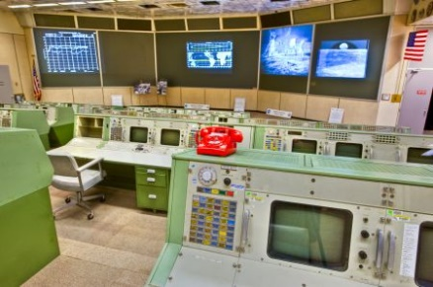
Test Control
Monitoring of the test activities
Comparing with the plan
Reporting status of deviations from the plan
Taking actions for correction
Updating the test plan according to the feedback

Slide 35
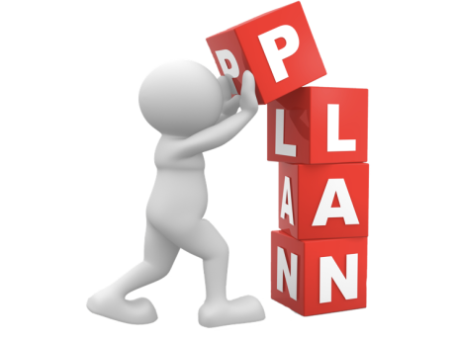
Test Plan
The results from the planning activities should be documented in a test plan
The test plan is a formal document that describes how tests will be performed
List of test activities to be performed to ensure meeting the requirements
Features to be tested, testing approach, schedule, acceptance criteria

Slide 36
Test Analysis And Design
Identify test conditions
Product specification may not be testable
Defining what should be tested starts with reviewing the test basis
Designing test cases

Slide 37
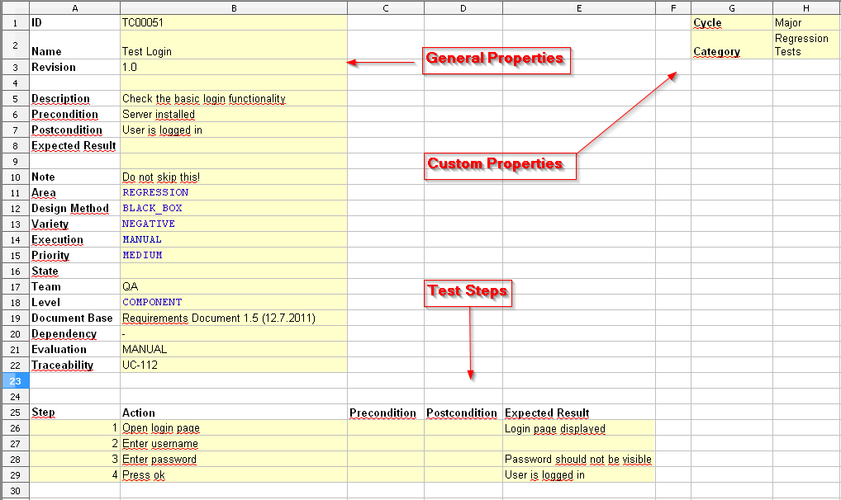
Test Case
Sequence of steps to check the correct behavior
At least two cases to fully test a requirement
A positive test
A negative test
Consist of
Title
Steps to follow
Expected result

Slide 38

Test Case (2)
Optionally may consist of
ID
Description
Related requirements
Test category
Author
Is automated
Pass/fail

Slide 39
Test Execution
How the tests will be executed?
Follows the priority of the test cases set in the test plan
Grouping test cases into test suites
For efficient test execution
For easier overview
Time pressure may cause running just a subset of all tests
Having tests prioritized is important

Slide 40
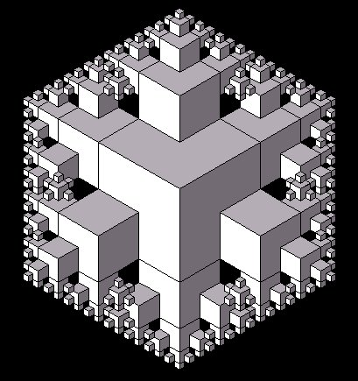
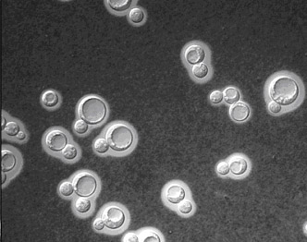
Reproducibility
The tests must be easily repeated
Test environment
Input data
Test logs
Etc.

Slide 41

Failure Found?
Is it really a failure?
Erroneous or inexact test specification
Problematic test infrastructure or test case
Incorrect test execution
If it is a failure:
The failure must be documented
Rough analysis of possible causes
Additional test cases might be required

Slide 42

Exit Criteria
What is exit criteria?
The set of generic and specific conditions for permitting a process to be officially completed
Agreed upon with the stakeholders
Used to report against and to plan when to stop testing

Slide 43
Exit Criteria - Example
100% statement coverage
100% requirement coverage
all screens / dialogue boxes / error messages seen
100% of test cases have been run
100% of high severity faults fixed
80% of low & medium severity faults fixed
maximum of 50 known faults remain
maximum of 10 high severity faults predicted
time has run out
testing budget is used up

Slide 44

Test Summary Report
The experience gathered should be analyzed and made available for further projects
Achieved results
Unexpected events
What were their causes?
Open change requests
Why were they not implemented?
User acceptance after deploying

Slide 45
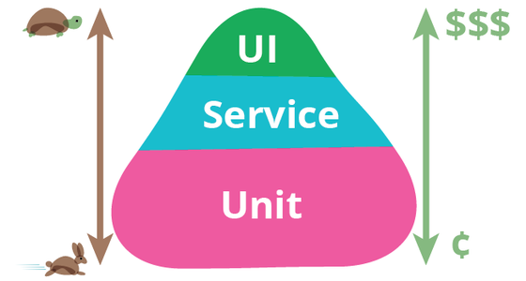
Test Triangle

Slide 46
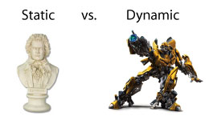
Static vs. Dynamic Techniques
Static tests
Aim to find problems in the design or concept of the prod.
Code is NOT being executed.
Dynamic tests
Aim to find problems in an instance of the product.
Code execution is mandatory.

Slide 47
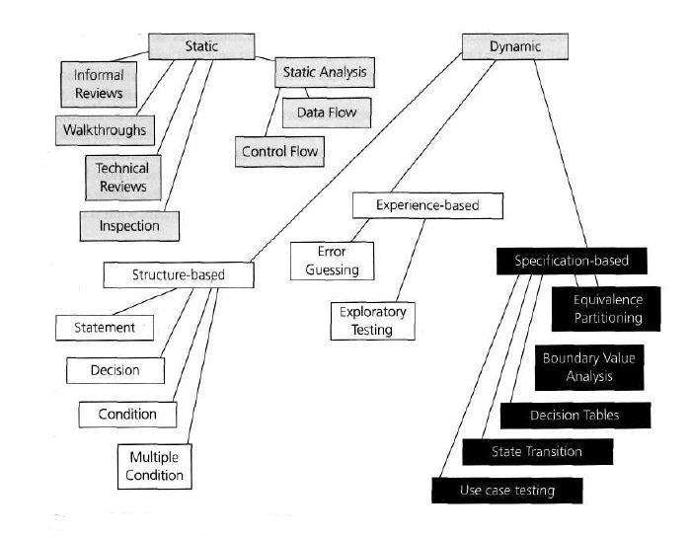
Graph of contents

Slide 48
Static Testing Techniques

Slide 49
Dynamic Testing Techniques

Slide 50
Black Box Testing Techniques

Slide 51
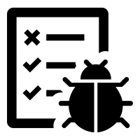
Seven Testing Principles (1)
Testing shows presence of defects
Testing can show that defects are present
Cannot prove that there are no defects
Appropriate testing reduces the probability for defects

Slide 52

Seven Testing Principles (2)
Exhaustive testing is impossible
All combinations of inputs and preconditions are usually almost infinite number
Testing everything is not feasible
Risk analysis and priorities should be used to focus testing efforts

Slide 53
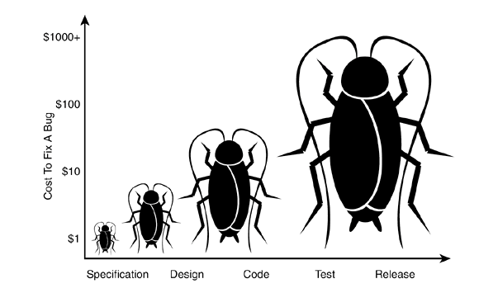
Seven Testing Principles (3)
Early testing
Testing activities shall be started as early as possible
And shall be focused on defined objectives
The later a bug is found – the more it costs!

Slide 54
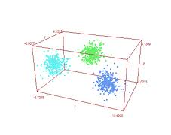
Seven Testing Principles (4)
Defect clustering
Testing effort shall be focused proportionally
To the expected and later observed defect density of modules
A small number of modules usually contains most of the defects discovered

Slide 55
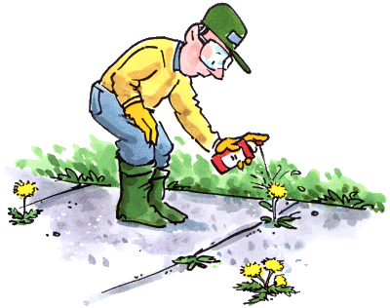
Seven Testing Principles (5)
Pesticide paradox
Same tests repeated over and over again tend to loose their effectiveness
Previously undetected defects remain undiscovered
New and modified test cases should be developed

Slide 56
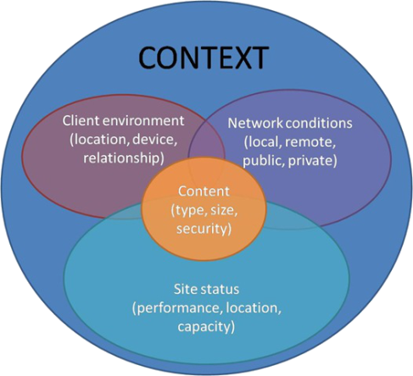
Seven Testing Principles (6)
Testing is context dependent
Testing is done differently in different contexts
Safety-critical software is tested differently from an e-commerce site

Slide 57

Seven Testing Principles (7)
Absence-of-errors fallacy
Finding and fixing defects itself does not help in these cases:
The system built is unusable
Does not fulfill the users needs and expectations

Slide 58

Summary
Software evolved through the time
Retail, web, mobile
It still has bugs
Reasons does not change
Importance of fixing bugs
More Customers
More money
No unsatisfied developers
…
…
…

Slide 59

Literature
QA Book: www.istqb.org/downloads/send/2-foundation-level-documents/3-foundation-level-syllabus-2011.html4
Tutorials: www.w3schools.com
Selenium: leanpub.com/selenium-webdriver-book
GitHub: github.com/QualityAssuranceTeam/source

Slide 60
https://softuni.bg/courses/technology-fundamentals

Slide 61













SoftUni Diamond Partners

Slide 62




SoftUni Organizational Partners

Slide 63




Trainings @ Software University (SoftUni)
Software University – High-Quality Education and Employment Opportunities
softuni.bg
Software University Foundation
http://softuni.foundation/
Software University @ Facebook
facebook.com/SoftwareUniversity
Software University Forums
forum.softuni.bg

Slide 64

License
This course (slides, examples, demos, videos, homework, etc.) is licensed under the "Creative Commons Attribution-NonCommercial-ShareAlike 4.0 International" license

